Slide 1


Software Quality Assurance (Manual Testing)
B2
Presented by
Farhad Hossain

Slide 2
Contents
What is Software?
Types of Software
What is Software Testing?
Why do we need Testing?
Error, Bug and Failure
Types of Software Testing
Manual Testing
Automation Testing
SDLC & SDLC Models
Testing Techniques
Levels of Testing
White Box, Black Box & Grey Box Testing
Functional Testing
Non-Functional Testing
Black Box Test Design Techniques

Slide 3
What is software?
A software is a computer program that provides a set of instructions to execute a user’s commands and tell the computer what to do.
Ex: MS-Word, MS-Excel, PowerPoint etc.

Slide 4
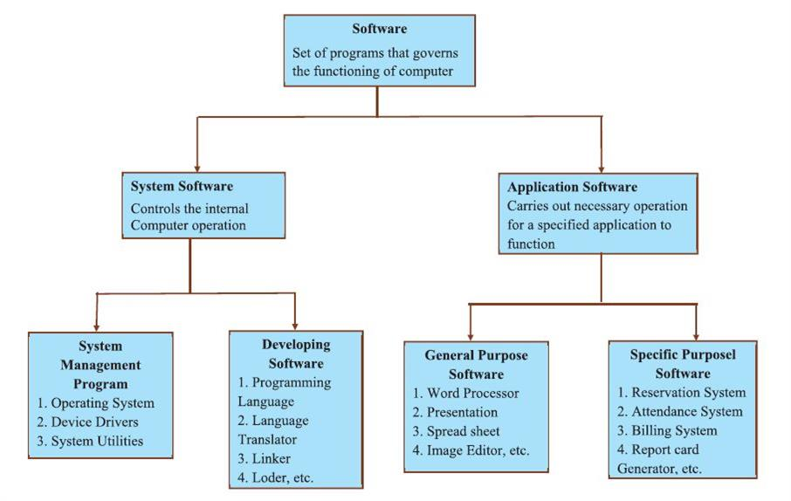
Types of Software

Slide 5
What is Software Testing?
Software Testing is a part of software development process.
Software Testing is an activity to detect and identify the defects in the software.
Goal- to deliver quality product to the customer/client.

Slide 6
Software Quality
Bug/Defect free
Delivered on Time
Within budget
Meets customer’s requirements
Maintainable

Slide 7
Error, Bug & Failure
Error : Incorrect human action —--Developer
Bug / Defect : Deviation of expected and actual result —-- Tester
Failure : The deviation identified by end user while using the system is called failure.

Slide 8
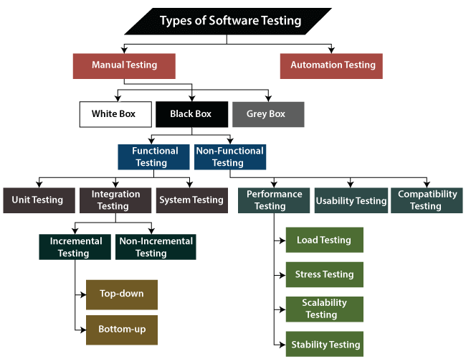
Types of Software Testing

Slide 9
Types of Testing
Manual Testing : Manual testing is a type of testing in which we do not take the help of any tools (automation) to perform the testing.
Automation Testing : Automation Testing is a type of software testing in which test cases are executed automatically by a tester using any automated tools.

Slide 10
Software Development Life Cycle (SDLC)
Software Development Life Cycle (SDLC) is a step by step process used by the software industry to design, develop and test high quality softwares.
SDLC steps:
Requirement analysis
Planning
Design
Development / Coding
Testing
Deployment
Maintenance

Slide 11
SDLC steps
Requirement Analysis: This is where teams examine the requirement analysis with inputs from clients, the sales department, market research reports and subject matter experts ------------> Business Analyst (BA)
Planning : Once gathering requirements is completed, the next step is to plan. From there, the terms of the project will be determined:
Cost estimation
Required resources
Tech stack
Roles needed in the project
Project scheduling
Leadership structure
------------->Project Manager (PM)

Slide 12
SDLC steps
3. Design : The third phase goes into great detail about the required standards, features, and activities that fulfil the functional specifications of the proposed system. ------------> Software Architect/ UI/UX Designer
4. Development : This phase of SDLC involves writing code and transforming design documentation into actual software. -------------> Software Developer
5. Testing : This stage of SDLC helps ensure the software has no bugs or exploits and can run smoothly. -------------> SQA Engineer
6. Deployment : Depending on the client’s requirements, the product might undergo User Acceptance Testing (UAT) where it is tested in a real business environment with a limited segment. Most businesses deploy their new products to a small percentage of users (10-15%) and slowly release them to the rest of the customer base. -------------> DevOps Engineer

Slide 13
SDLC steps
7. Maintenance : The final SDLC phase entails maintenance and regular upgrades. This stage concentrates on keeping the software safe, increasing performance, and occasionally adding new features. --------> Support Engineer / Tester / Developer

Slide 14
SDLC Models
Waterfall Model
Agile Model
Spiral Model
Rapid Application Development (RAD) Model
V-Model

Slide 15
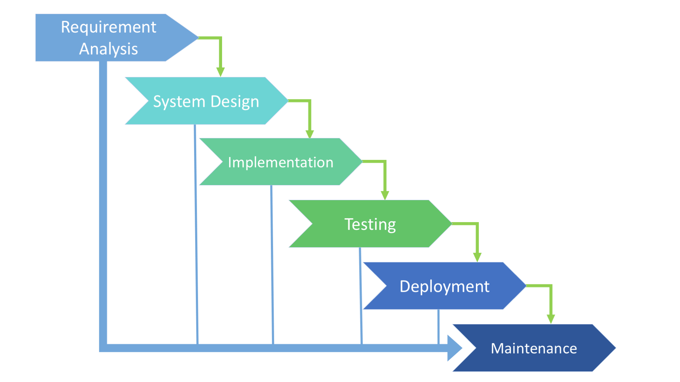
Waterfall Model

Slide 16
Advantages of Waterfall Model
Quality of the product will be good since every phase has clear documentation.
Since requirement changes are not allowed , chances of finding bugs will be less.
Initial investment is less because the testers are hired at the later phases/ stages.
Suitable for small projects where requirements are fixed/ freezed.

Slide 17
Disadvantages of Waterfall Model
Requirement changes are not allowed.
If there is bug/defect in requirement that will be continued for later stages.
Total investment is more.
Testing will start only after coding.

Slide 18
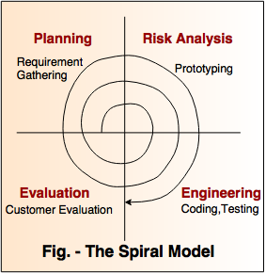
Spiral Model

Slide 19
Advantages of Spiral Model
Testing is done in every cycle, before going to the next cycle.
Customer will get to use the software for every model.
Requirement changes are allowed after every cycle before going to the next cycle.

Slide 20
Disadvantages of Spiral Model
Requirement changes are not allowed in between the cycle.
Every cycle of spiral model looks like waterfall model.
There is no testing in requirement and design phase.

Slide 21
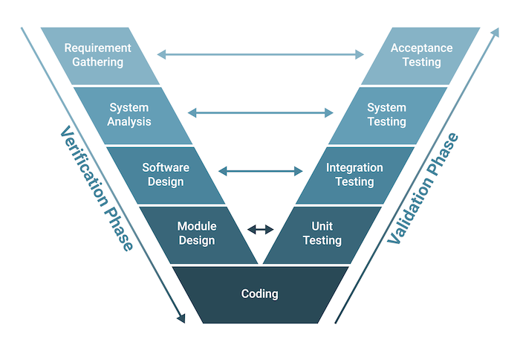
V-Model

Slide 22
Advantage and Disadvantages of V-Model
Advantage :
Testing is involved in each and every phase.
Disadvantages :
Documentation is more.
Initial investment is more.

Slide 23
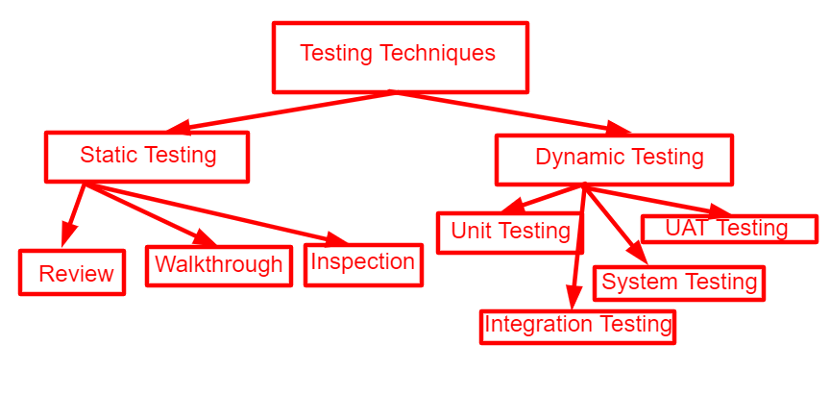
Testing Techniques

Slide 24
Levels of Testing
Unit Testing : Unit testing involves the testing of each unit or an individual component of the software application. It is the first level of functional testing.
Integration Testing : Integration testing is the second level of the software testing process comes after unit testing. In this testing, units or individual components of the software are tested in a group.
System Testing : System Testing is the testing of a complete and fully integrated software product.
User Acceptance Testing : User Acceptance Testing (UAT) is a type of testing performed by the end user or the client to verify/accept the software system before moving the software application to the production environment.

Slide 25
White Box, Black Box and Grey Box Testing
White Box Testing : White Box Testing is a software testing technique that focuses on the software’s internal logic, structure, and coding.
Black Box Testing : Black box testing is a testing technique in which the internal workings of the software are not known to the tester. The tester only focuses on the input and output of the software.
Grey Box Testing : Grey Box Testing is a software testing technique that is a combination of the Black Box Testing technique and the White Box Testing technique.

Slide 26
Functional Testing Types
Smoke Testing : Smoke Testing is a software testing process that determines whether the deployed software build is stable or not.
Sanity Testing : Sanity testing is a testing technique that is used to check that specific functionality or components of a software application are working as expected after making changes or fixing defects.
Regression Testing : This type of testing concentrate to make sure that the code changes should not side effect the existing functionality of the system.

Slide 27
Non-Functional Testing Types
Performance Testing : Performance testing is a type of software testing that ensures software applications perform properly under their expected workload.
Security Testing : Security testing is a type of software testing that focuses on evaluating the security of a system or application. The goal of security testing is to identify vulnerabilities and potential threats and to ensure that the system is protected against unauthorized access, data breaches, and other security-related issues.
Recovery Testing : Recovery testing is a type of system testing which aims at testing whether a system can recover from failures or not.

Slide 28
Non-Functional Testing Types
Usability Testing : Usability testing is a type of testing to check how easy and user friendly a software is. It is also called User Experience (UX) Testing.
Installation Testing : Installation testing is a type of software testing that focuses on verifying the installation process of a software application. Its primary goal is to ensure that the installation, upgrade, or uninstallation of the software proceeds smoothly and without errors.
Compatibility Testing : Compatibility testing is a type of Software testing to check whether your software is capable of running on different hardware, operating systems, applications, network environments or Mobile devices.

Slide 29
Black Box Test Design Techniques
Equivalence Partitioning (EP)
Boundary Value Analysis (BVA)
Decision Table Testing
State Transition Testing

Slide 30
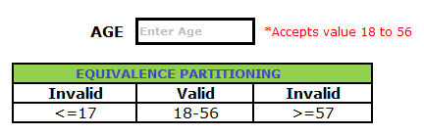
Equivalence Partitioning (EP)

Slide 31
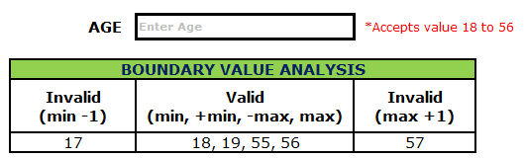
Boundary Value Analysis (BVA)

Slide 32
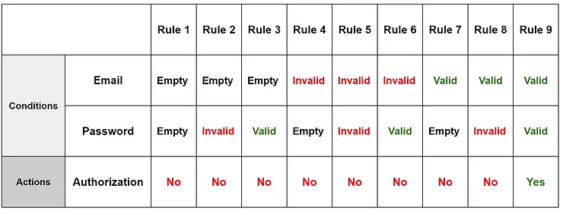
Decision Table Testing

Slide 33
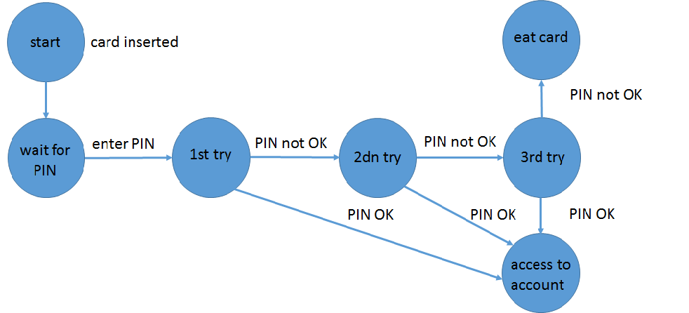
State Transition Testing

Slide 34
Software Testing Life Cycle (STLC)
Software Testing Life Cycle (STLC) is a process used to test software and ensure that quality standards are met.
STLC steps:
Requirement Analysis
Test Planning
Test Case Development
Test Environment Setup
Test Execution
Test Cycle Closure

Slide 35
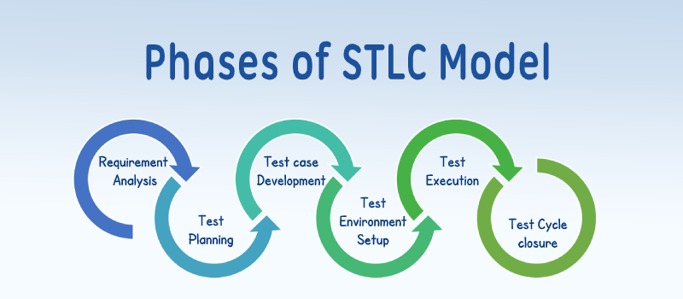
Software Testing Life Cycle (STLC)

Slide 36
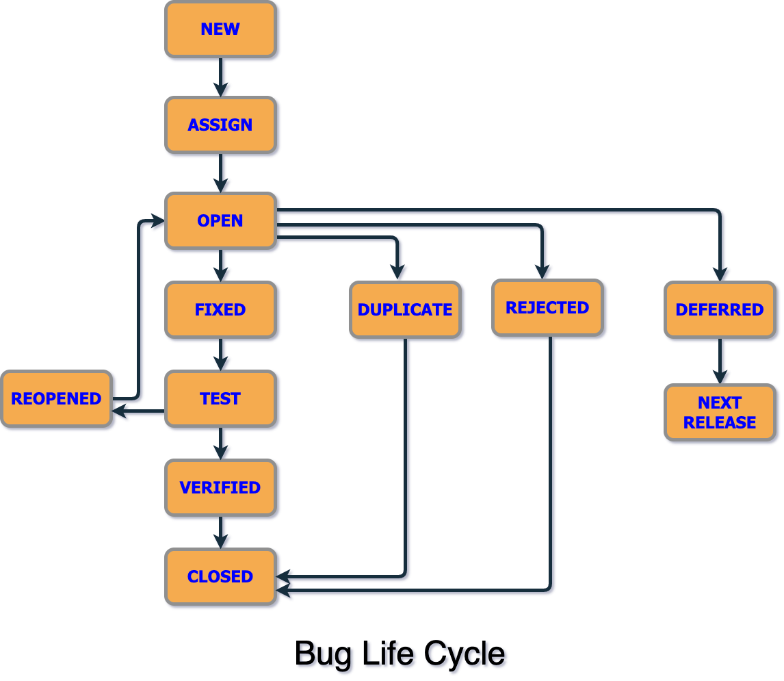
Defect/Bug Life Cycle
The defect/bug life cycle is a process that describes the stages a software defect or bug goes through from the moment it's discovered until it's fixed and verified.

Slide 37
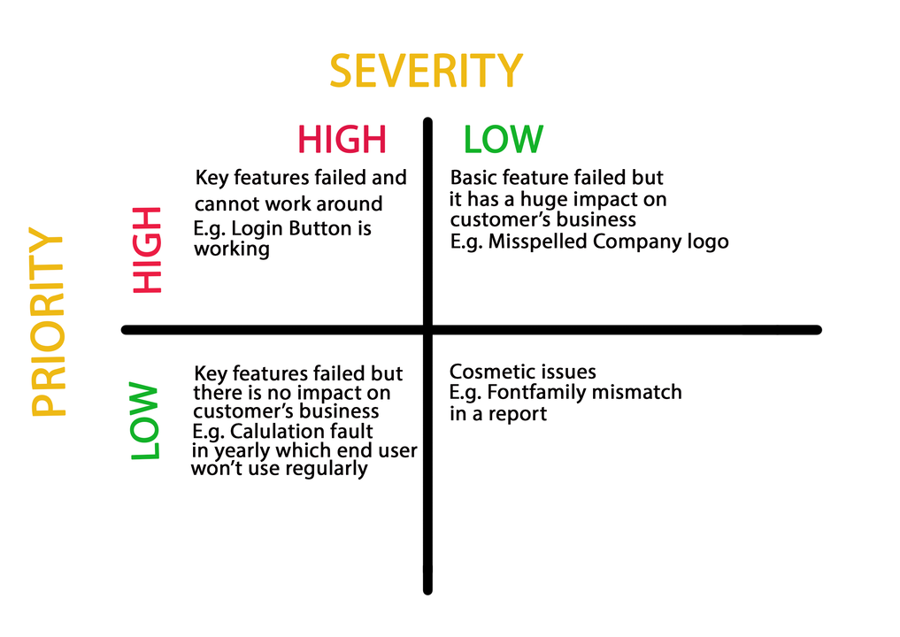
Severity and Priority

Slide 38
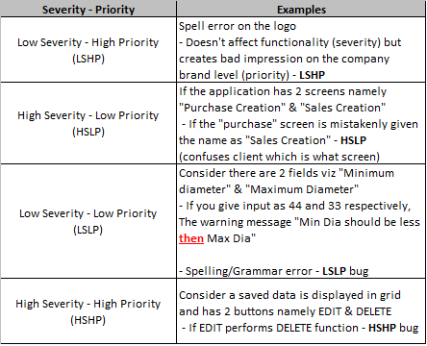
Severity and Priority

